Slide 1
Public Health, Alcohol Regulation and the Three-Tier Distribution System James F. Mosher, JD Alcohol Policy Consultations Addictions organizers conference call, March 19, 2013, General Board of Church and Society, United Methodist Church

Slide 2
The Alcohol Distribution
Three-Tier System
Producer
Direct Shipment Laws
Tied House Laws
Wholesaler
Retailer
Consumers

Slide 3
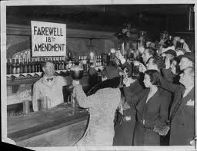
Public Health Goals of the Three-Tier System
Deter undue producer influence on retailers
Sales and advertising practices
Reduce competition; maintain an orderly market
Restrict quantity discounting
Maintain minimum prices
Protect small retailers
Deter sales to minors

Slide 4
Wholesaler Tier
Under attack by big-box retailers and producers
In “control” states, operated by the state (either directly or through contract)
Highly profitable
Until recently, private wholesalers have been strong opponents of public health initiatives

Slide 5
Fundamental Question
Is alcohol an ordinary commodity subject to the same market pressures and rules as other consumer products?
Federal Trade Commission, alcohol producers, big box retailers:
YES!
Public health and wholesalers:
NO!

Slide 6
Regulatory Measures At Risk (through court and legislation action)
Measures directly related to the three tier system:
Restrictions on direct shipments
Quantity discounts; minimum pricing
Restrictions on producer/wholesaler promotions for retailers
Push to privatize state retail and wholesale operations
Protection of wholesaler tier

Slide 7
Regulatory Measures At Risk (through court and legislation action)
Measures indirectly related to the three-tier system
Restrictions on alcohol advertising/marketing
Restrictions on days and hours of sale
Restrictions on type, number, and location of retail outlets
Other restrictions on alcohol availability and marketing

Slide 8
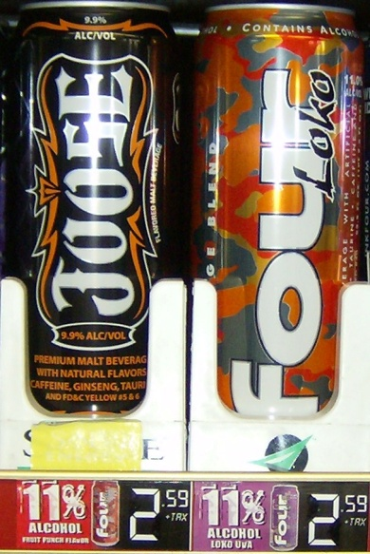
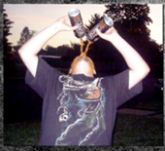
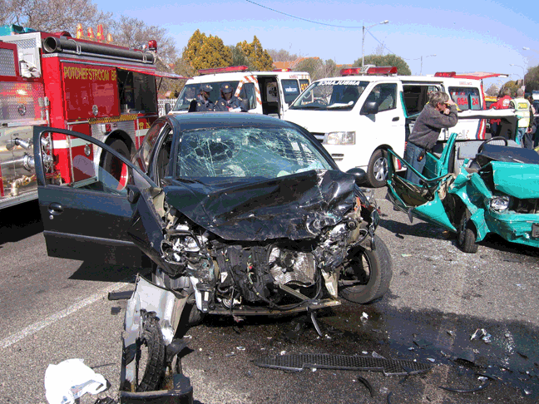
What the Science Tells Us
Increased alcohol prices/taxes
Decreased alcohol consumption
Decreased public health/safety problems
Source: CDC Community Guide 2010

Slide 9
What the Science Tells Us: Alcohol Availability
Increased alcohol availability
Increased alcohol consumption
Increased public health/safety problems
Source: Babor et al. 2010

Slide 10
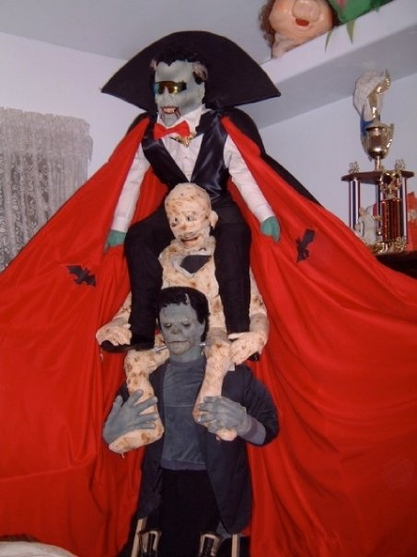
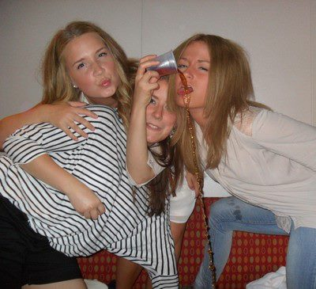
What the Science Tells Us: Youth Exposure to Alcohol Marketing
Increased youth exposure
Increased intention to drink
Earlier initiation/increase in drinking
Source: Anderson, et al. 2009; Babor et al. 2010

Slide 11
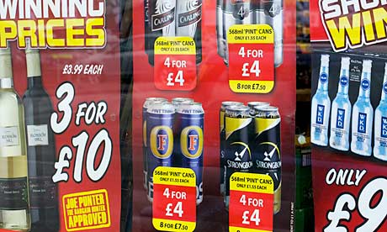
Great Britain A case study in the risks of treating alcohol as an ordinary commodity
The Guardian Headline:
Hospital admissions due to drinking double in 10 years
Doctors' leaders call for stricter controls over the sale of alcohol, including minimum pricing

