Slide 1
Alcohol Density
&
Community Safety
Presentation Agenda
CPP/CURB Background
Overview of the Local Problem
Alcohol Density-why it’s a problem
Tools for reshaping the problem
Current efforts in SCC
Q&A/Discussion
March 3, 2015

Slide 2
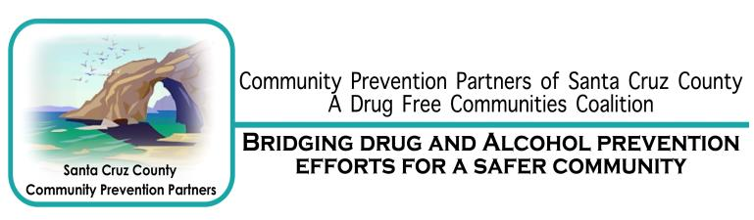

CPP/CURB Background
Notes:
Started 1991-high rates of alcohol consumption among youth (TFY)
Taken on various AOD prevention issues/topics
Efforts are to address our mission and purpose
CPP’s Mission: Santa Cruz County Community Prevention Partners are dedicated to building a diverse community that promotes health and wellbeing, and enhances youth and community safety through sustainable drug and alcohol prevention efforts.
Project CURB-2004-6th in the state for high rates of binge drinking
Focus on adult provision of alcohol to minors
Been successful in many areas:
Addressing meth/meth labs
RAMA (14 years!)
County-wide SHO (previous sheriff was champion of)
Reducing party houses
decreasing binge drinking-10% in the last several years
Data has guided us to our Current focus: MJ, Rx, Alc.-specifically alcohol outlet density

Slide 3
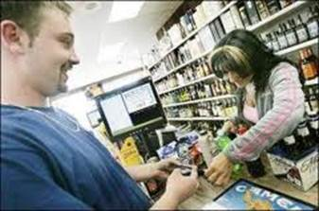
Overview of the Local Problem
75% of Santa Cruz County 11th graders say that alcohol is fairly easy/very easy to access
Notes:
Although we have seen positive change, party as a result of our efforts-Access, use, and consequences of underage drinking, as you all well know, are still a big issue in our community
30 day use 11th grade 34%
30 day binge 11th grade 21%
CHKS 12-14

Slide 4
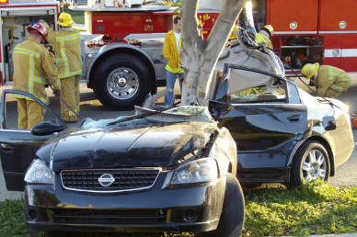
Overview of the Local Problem
Over 1 in 4 Santa Cruz County 11th graders report driving after drinking.
Notes:
This slide was put together before Sunday’s tragedy- I would like to share these local stats with you
26% 11th graders driven drunk
42% have driven in a car as passengers with someone else who has been drinking
CHKS 12-14
We also know violent behaviors increase when intoxicated-more about this later in the presentation
Lets take a look at how our environment impacts the decisions of our youth

Slide 5
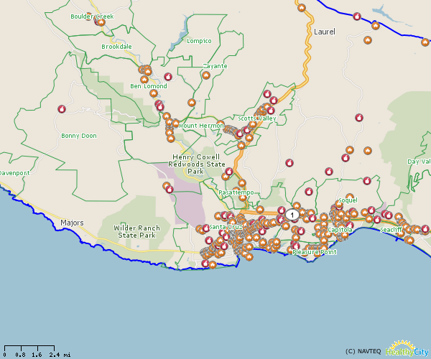
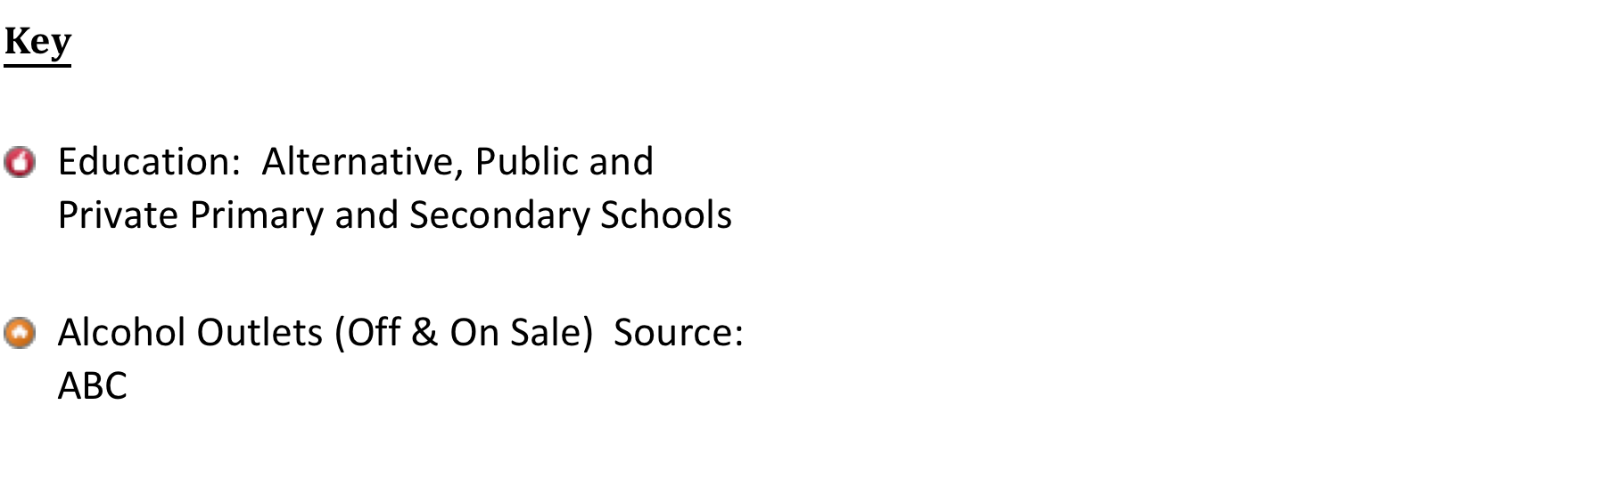
North County Alcohol Outlets
Notes:
I’de like to move us now to what this looks in our geographic region
This map shows all of the off and on sale outlets in North County (brown house icons)
Red icons are schools
Notice proximity of schools to outlets

Slide 6
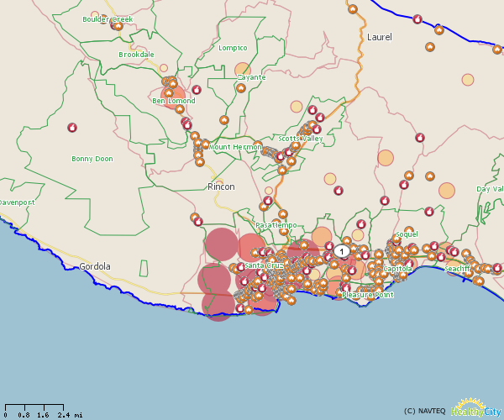
North County Alcohol Outlets & Poverty
Increase in outlets resulting in an increase in violence, was four times more likely in neighborhoods with a high minority population and lower incomes
Notes:
Notice what this looks like when overlaid with poverty
The more orange the circles, the more people in that area living below the Federal poverty level
There is a lot of existing research that points to the strong relationships between outlet density, violence, poverty, and minority populations
We see this here- dark orange areas have a higher concentration of outlets
Datasource: American Community Survey 5-Year Estimates. Data Year: 2007 - 2011. Data Level: Census Tract (2010)
People Living below, near and above Census Poverty Threshold: Less than 50% of poverty level
0.0 % - 1.39 %
1.4 % - 2.49 %
2.5 % - 3.49 %
3.5 % - 4.59 %
4.6 % - 6.09 %
6.1 % - 8.39 %
8.4 % - 11.89 %
11.9 % - 100.0 %

Slide 7
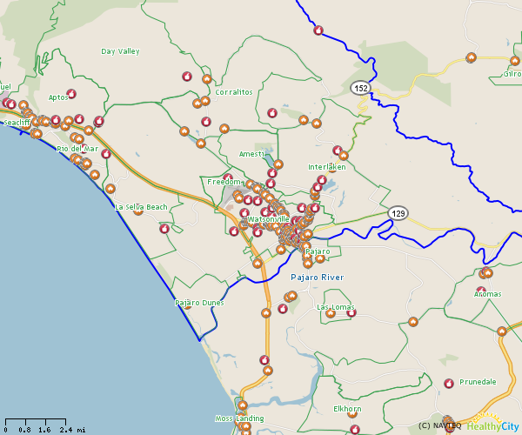
South County Alcohol Outlets
Notes:
Here is the same map for South county-without the poverty
Again, take a look at the proximity of schools to the outlets

Slide 8
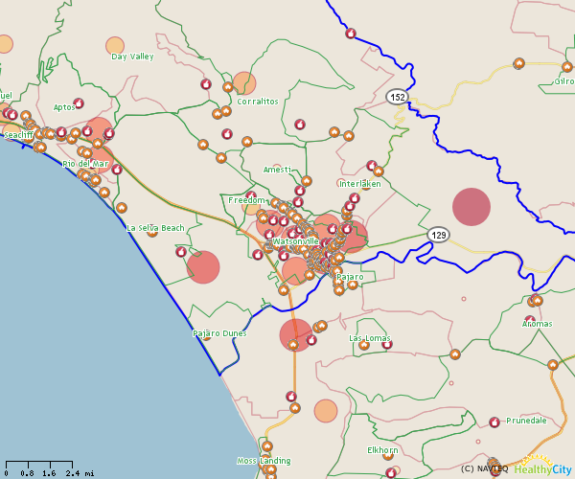
South County Alcohol Outlets & Poverty
Notes:
And we see the same pattern in South County-areas of higher outlets also areas of higher poverty
Datasource: American Community Survey 5-Year Estimates. Data Year: 2007 - 2011. Data Level: Census Tract (2010)
People Living below, near and above Census Poverty Threshold: Less than 50% of poverty level
0.0 % - 1.39 %
1.4 % - 2.49 %
2.5 % - 3.49 %
3.5 % - 4.59 %
4.6 % - 6.09 %
6.1 % - 8.39 %
8.4 % - 11.89 %
11.9 % - 100.0 %

Slide 9
Watsonville Alcohol Outlets & Crime
Adding one bar to a block increases the risk of murder taking place on the block by 5%, and the risk of having a violent crime of any type by 17.6%
Notes:
We have been working with WPD on this project and were able to get crime data and map it with outlets
You can see that where there are more outlets, there is higher crime
Hoping to create this type of overlay map for SCC Unincorporated areas

Slide 10
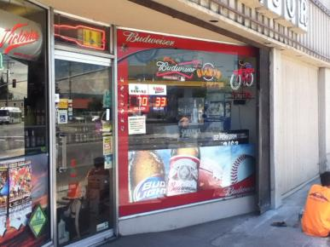
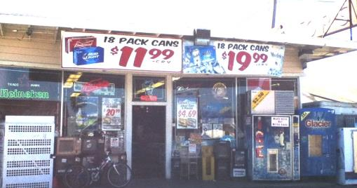
Local Impact
Youth, in particular “Latino youth who live farther from alcohol retailers are less likely to drink. Increasing the distance to retailers is significantly associated with an increase in alcohol consumption.”
Notes:
Impacts are great- higher consumption leading to all types of individual and community consequences that decreases the safety and wellbeing of our community
Pass it to Jim Mosher to describe further the issue of alcohol outlet density and potential solutions.

Slide 11
Addressing Community Problems Related to Retail Alcohol Outlets in Santa Cruz County
James F. Mosher, JD
Alcohol Policy Consultations
March 3, 2015

Slide 12
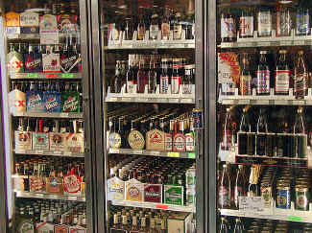
Key Dimensions of Local Retail Alcohol Availability

Slide 13
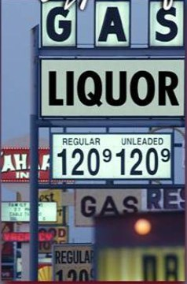
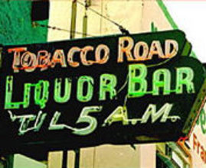
Types of Alcohol Outlets
Off-sale Outlets
Liquor stores
Convenience stores
Supermarkets
Gas stations
On-sale Outlets
Bars/lounges
Restaurants
Airplanes, trains, etc.
Festivals

Slide 14
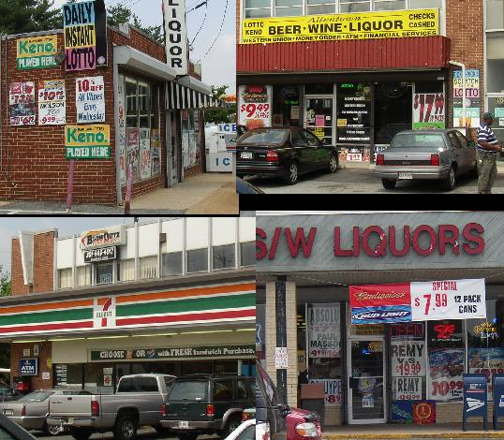
Number of Alcohol Outlets
Outlet over-concentration:
A key public health and safety concern

Slide 15
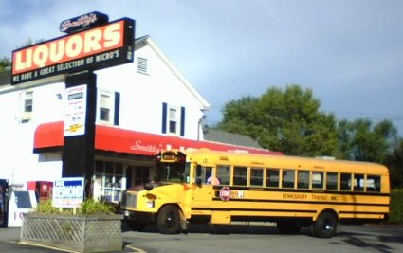
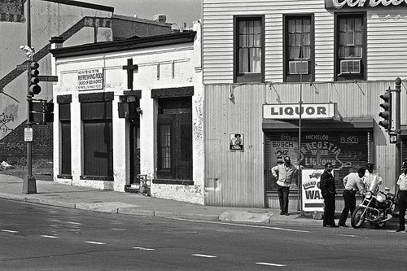
Location of Alcohol Outlets
Sensitive Locations
Schools
Playgrounds
Libraries
Churches
Hospitals
Alcoholism treatment facilities

Slide 16
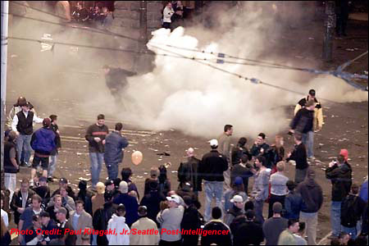

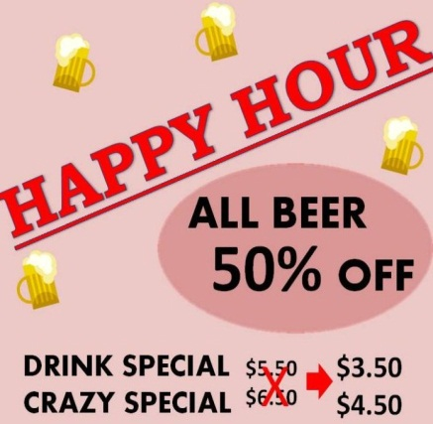
Selling and Serving Practices
Problem Practices
Furnishing minors
Service to intoxicated persons
Public nuisance activities

Slide 17
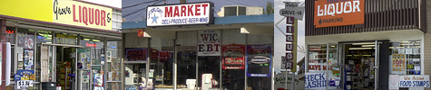
What the Science Tells Us:
Alcohol Availability
Increased alcohol availability
Increased alcohol consumption
Increased public health/safety problems
Source: Babor et al. 2010

Slide 18

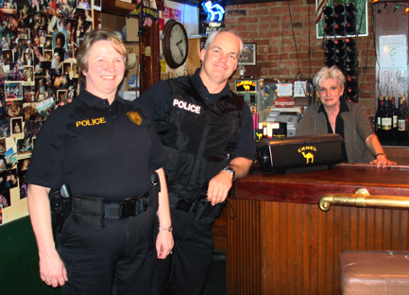
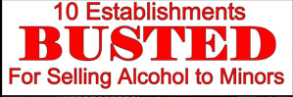
What the Science Tells Us:
Active Enforcement of Retail Licensing Laws
Increased enforcement
Decreased binge & underage drinking
Decreased public health/safety problems
Source: Babor et al. 2010

Slide 19
Alcohol Outlet Density:
Community Guide Summary of the Research
“[T]he Task Force found sufﬁcient evidence …to recommend limiting alcohol outlet density through the use of regulatory authority (e.g., licensing and zoning) as a means of reducing or controlling excessive alcohol consumption and related harms.”
Guide to Community Preventive Services, Centers for Disease Control and Prevention, 2009.

Slide 20
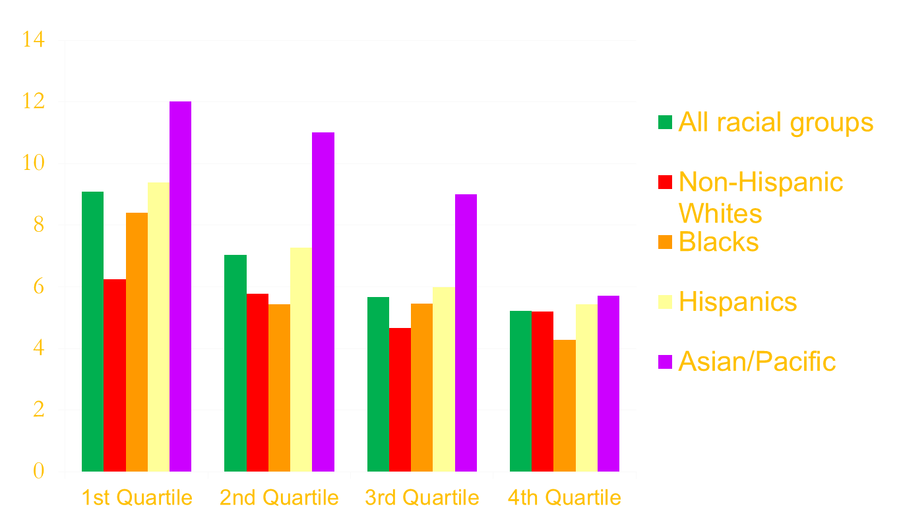
Mean Number of Alcohol Outlets Near Residences by Race/Ethnicity & Income
(California, 2003)
Mean # of Alcohol Outlets
Income Quartile
Truong & Sturm 2009

Slide 21
Tools for Shaping Community Retail Alcohol Environments
Conditional Use Permits (new outlets)
Nuisance Abatement/Deemed Approved Ordinances (all outlets)
Responsible Beverage Service Programs
Monitoring and Enforcement
Fees

Slide 22

Conditional Use Permit (CUP)
Focuses on how alcohol will be made available in new retail settings

Slide 23
Conditional Use Permit
Key components include:
  Types, number, location and distance requirements.
  Operational conditions (restrictions on sales and service practices).
  Procedures for obtaining public input as an integral part of decision-making process.
  Procedures for reviewing violations and potentially suspending or revoking permit.

Slide 24
Santa Cruz City
CUP Provisions
Low-Risk Alcohol Outlet. Bona fide restaurant, wine-tasting room, brewpub and similar establishments that include food service but do not include live entertainment and food stores.
High-Risk Alcohol Outlet. Bars, taverns, liquor stores, convenience stores, nightclubs, and premises where live entertainment and/or dancing occurs.

Slide 25
Santa Cruz City
CUP Provisions
High risk establishments:
Must obtain a Special Use Permit
Cannot be located within 600 feet of another high risk establishment.
Servers must be 21 years of age.
Special security measures may be required.

Slide 26
Santa Cruz City
CUP Provisions
Proposal before the City Council:
Any establishment open after midnight will be considered a high-risk alcohol outlet (18 businesses would be reclassified).

Slide 27
Current Santa Cruz County Provisions re Alcohol Outlets
Zoning code defines high risk alcohol outlets (bars, taverns, liquor stores, convenience stores).
Firearm dealers are not permitted within 600 feet of a high risk alcohol outlet.
Only time the term is used in the code.

Slide 28
Current Santa Cruz County Provisions re New Alcohol Outlets
Alcohol retailers not required to obtain a CUP (except gas stations that sell beer and wine).
Alcohol retailers larger than 500 sq. feet in certain commercial districts can only be open during evening and weekend periods.
Special review required for alcohol outlets within 200 feet of a residential or recreational district.
Otherwise, alcohol outlets treated the same as any other business.

Slide 29
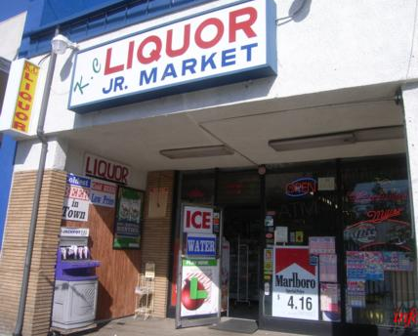
Nuisance Abatement/
Deemed Approved Ordinance (DAO)
Focuses on controlling problems with both pre-existing and new retail outlets

Slide 30
DAO standards may:
Specify types of activities that constitute a public nuisance.
Require retailers to operate in a manner that is compatible with surrounding land uses.
Require retailers to protect public health and safety of surrounding community.
Establishes procedures for abating nuisances and imposing fines, suspension and revocations.
Provide procedures for determining when a pre-existing outlet must obtain a CUP (retriggering).

Slide 31
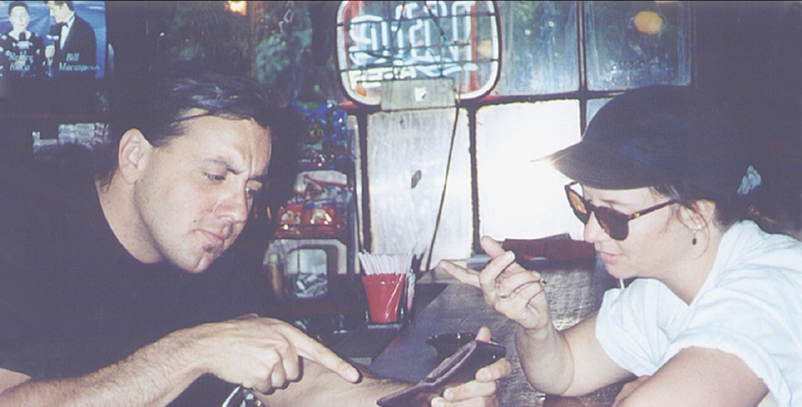
Responsible Beverage Service (RBS) Programs
Focuses on developing and implementing management policies and staff training that reduce risks of serving minors, serving intoxicated persons, and engaging in public nuisance activities.
High risk establishments in Santa Cruz City must provide training to all staff who serve alcohol.

Slide 32
Monitoring and Enforcement
Key components:
Dedicated law enforcement officer(s)
Community advisory panel
Collaboration with CA ABC Department
Notes:
Dedicated law enforcement officer(s) with expertise in enforcing CUP and DAO provisions.
Community advisory panel that monitors local government’s administration and enforcement.

Slide 33

Monitoring and Enforcement
National Liquor Law Enforcement Association
Improve standards for alcohol law enforcement practice
Promote professional development
Collaborate with state and law enforcement agencies
Foster a cooperative and mutually beneficial working relationship with alcohol research and public health organizations
Notes:
Dedicated law enforcement officer(s) with expertise in enforcing CUP and DAO provisions.
Community advisory panel that monitors local government’s administration and enforcement.

Slide 34
Monitoring and Enforcement:
Santa Cruz City Data
249 alcohol outlets
6 chronic nuisance businesses
Average annual police calls for service for businesses open past midnight: 176
Average annual police calls for service for businesses closed before midnight: 11

Slide 35
Nuisance Mitigation & Permit Fees
Revenue for implementation and enforcement of CUPs, DAOs, and RBS programs can be generated by imposing fees on alcohol outlets.
Fees reimburse local government for costs associated with ordinance implementation and enforcement.
Sliding scale can be developed so that higher risk establishments pay higher fees.

Slide 36
Santa Cruz City
Alcohol Impact Fees
$226 - $1,674 per alcohol outlet.
Fee scale based on closing time and sales volume
High risk: close after midnight, sales volume more than $300,000

Slide 37
Watsonville Alcohol Ordinance: Highlights
CUP for all new alcohol outlets
Distance requirements (stricter for bars, liquor stores and convenience stores)
Deemed Approved Ordinance with nuisance abatement standards and procedures for suspension and revocation
Ban on malt liquor and fortified wine containers larger than 16 ounces
Ban on malt liquor and fortified wine sales in individual containers.
Liquor store windows must be unobstructed and signage limited to 20% of total window area.

Slide 38
Watsonville Alcohol Ordinance: Proposals Under Consideration
DAO fee to fund a dedicated law enforcement officer position.
Stricter restaurant definition and distance requirements.
Citizen advisory committee to assist in implementation of DAO and CUP requirements.
Mandatory Responsible Beverage Service training for all alcohol servers and managers.

